Slide 1


Intelligent
Information Security
VMsources Group Inc.
A Comprehensive Approach to security for Organizations

Slide 2
Agenda
The Challenges
“Where's the Beef?”
Identify the Challenges
Intelligent Information Security: Prevention, Remediation, Training (PRT)
  Prevention – Preventing issues before they happen , utilizing active technologies to stop hackers before they hit gold
  Remediation -- Being able to recover quickly & quietly when events do happen
  Training – Educating users to avoid malware
Secure Cloud Computing
  VMsources Secure Multicloud
Notes:
Thank you for joining me today. In the next few minutes I’m going to talk about some of Information Security issues facing Organizations today
We’ll go over the most significant issues first
Then I’m going to provide some meaningful suggestions for improvement using our TPR Methodology

Slide 3
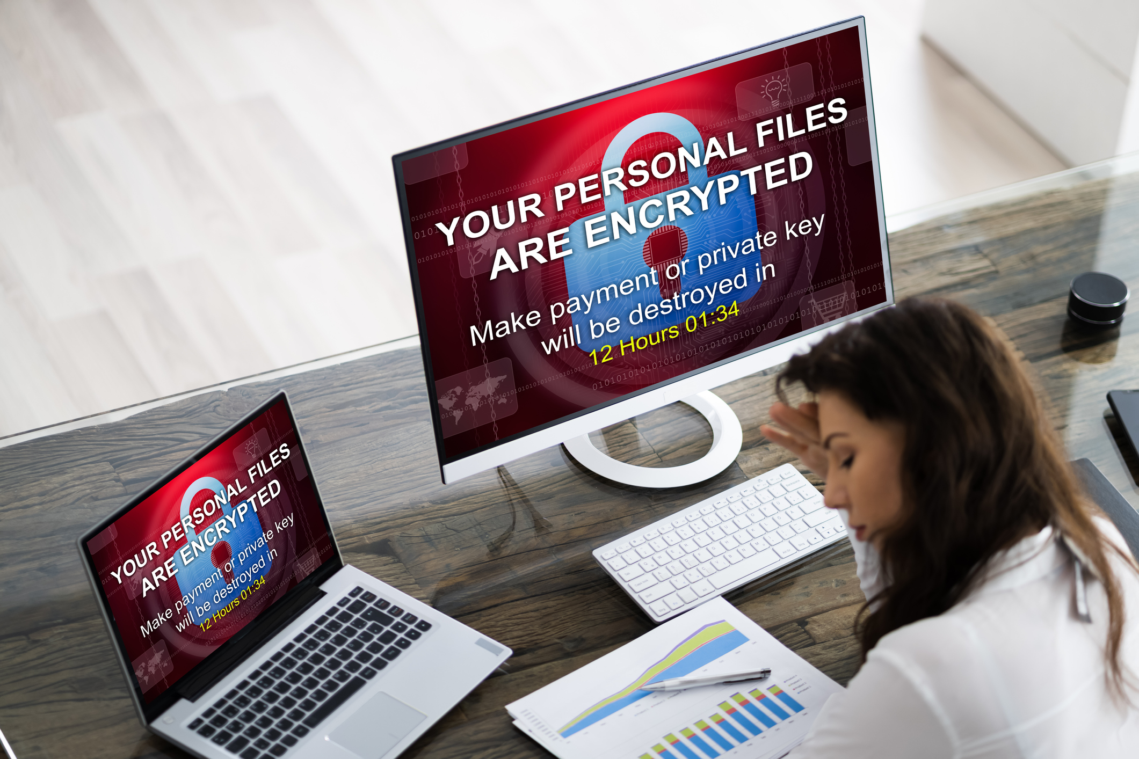

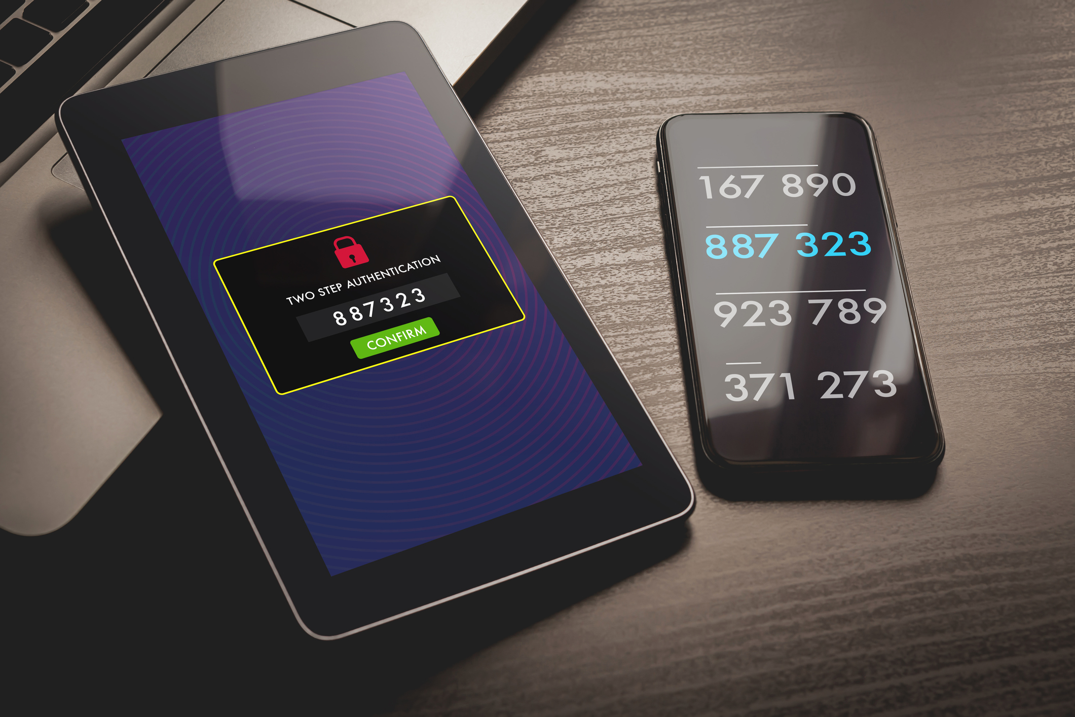


The Challenges
Ransomware
Theft
Identity Verification
Phishing
Business Continuity
Network and security flaws allow Ransomware to spread through an Organization like fire
Hackers are using new attack vectors to steal Organizational data and demand payments
Organizations encourage bad security by using obsolete policies and authentication methods
Lack of active filters subject users to sophisticated phishing emails on a daily basis
Many Organizations are unprepared to rapidly remediate Ransomware or failover in a disaster
Notes:
The primary challenges facing Organizations today are Ransomware, Theft, Identity Verification, Phishing and Business Continuity
The real challenge is keeping your systems online and minimizing disruptions, no matter what occurs!

Slide 4
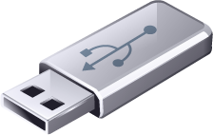

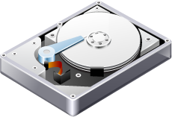

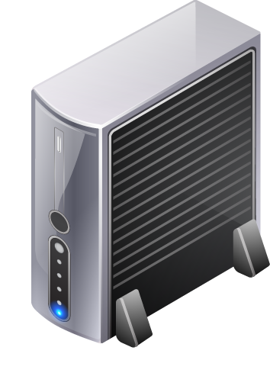

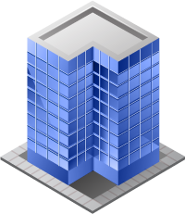


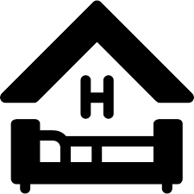

Where's the beef?
The “beef” is your organization’s proprietary data and work product, and it needs to be protected and secure
Unmanaged
USB
Proprietary
Data
Unmanaged
Home Router
Enterprise
Firewall
Unmanaged
USB
Corporate HQ /
Datacenter
Open WiFi
Network
Proprietary
Data
Notes:
In 1984, Clara Peller asked: “Where’s the Beef?”
Today “the Beef” is your organization’s proprietary data and your employees work product.
In most Organizations , it’s very likely that “the Beef” is distributed across devices ranging from home PC’s to USB drives
And users are connecting to the Organization using a variety of methods, ranging from VPN to LogMeIn to Virtual Desktop Infrastructure
It’s important to understand where your Organizations proprietary data and work product are located
and how users are connecting to the Organization.

Slide 5
Ransomware
Networking is often the problem
Ransomware is becoming more sophisticated.
  Increased use of VPNs for remote users from unsecured networks has opened the door
  Brute-force password and remote code execution are common vectors
  Lack of network segmentation allows propagation.
Recent front-page events like the Pipeline shutdown were the result of an insecure VPN
  This event could have been prevented by following the recommendations we are going to present here
Notes:
Ransomware is on everyone's mind.
In the old days, Ransomware was deployed through email payloads.
Now it’s becoming more sophisticated as Hackers seek new vectors.
Recent Ransomware events, like the pipeline shutdown, were the result of brute-force password attacks against VPN connections and failure to segment networks.
This front-page event was entirely preventable simply by following the concepts and recommendations we are going to discuss today.

Slide 6
Theft
New challenges for your Organization
Hackers used to disrupt Business Continuity and seek ransom payment
Now hackers also steal Organizational data and seek ransom payment(s) to not release the data
  Obviously, there’s no guarantee that they won’t keep coming back
Notes:
Nowadays, Hackers don’t simply seek to encrypt files, they will also try to steal your data.
If they hit the jackpot, it’s likely they will demand a ransom, in order not to release your Organizations data!
Unfortunately, even if you pay the ransom, there’s no guarantee that the Hackers won’t keep coming back for more.
What’s worse, Hackers may use your data to compromise other individuals and Organizations you work with like: vendors, clients, agencies, etc.

Slide 7
Digital Identity
A username and a password are not enough anymore!
Bad password policies leave Organizations vulnerable
  Password policies should comply with: NIST Digital Identity Guidelines 800-63-3
Brute-force attacks without additional verification allow hackers directly onto proprietary systems
Users often leave workstations unlocked
It is common practice to share user accounts and passwords in order “to get it done”
Notes:
Digital Identity is another BIG topic. Most people aren’t doing enough.
In fact, the majority of Organizations follow outdated and counterproductive Digital Identity guidelines.

Slide 8
Phishing
It’s not all about deploying payloads anymore
Hackers are developing more sophisticated Phishing attacks all the time
It used to be all about delivering a Ransomware payload
Now, Phishing attacks often identify key players in an organization for specifically target attacks:
  Phishing from “customer” to AR at your Organization: “Please send future ACH transfers to this new address”
  Phishing from “employee” to payroll at your Organization: “I changed banks, please send my paycheck…”
  Phishing from “court” to payroll at your Organization: “John Q. Public is in default, direct 50% of paycheck to…”
Notes:
We’ve all heard of phishing, some of us may have even been victims in one way or another.
Practically every day, we hear about someone not getting a paycheck or ACH being redirected all because of a fraudulent email request that looked perfectly legitimate.

Slide 9
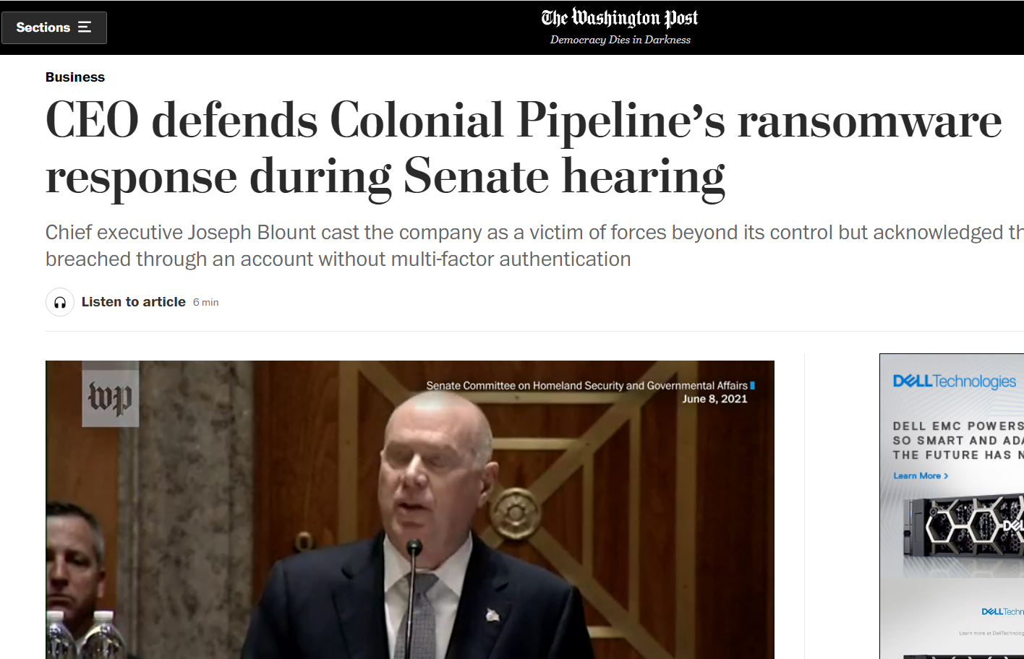
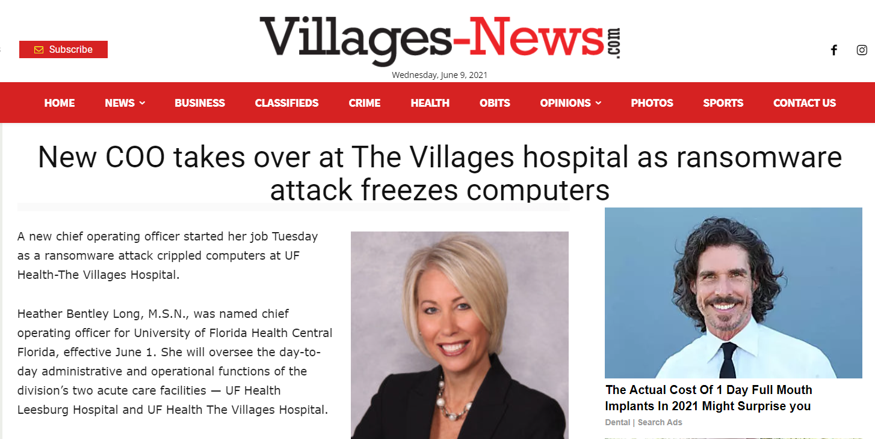
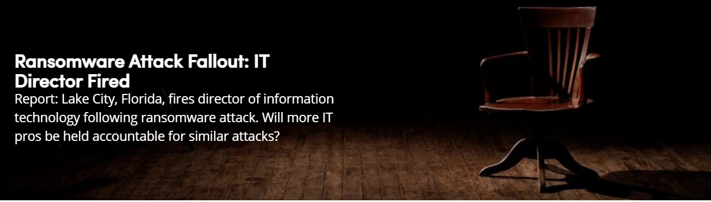
Business Continuity
Read All About It…
Ransomware events are likely to occur, even with the best protections in place
The key is in being able to recover quickly & quietly, without having to pay ransom
Avoid significant disruptions to Business Continuity
Don’t let you or your Organization become headline news!
Notes:
Business Continuity is an issue all by itself.
Thing is: If you can recover quickly from any event, it remains an internal matter.
If your Organization is offline for a week, it becomes headline news.

Slide 10
Staying Safe
A Simple, affordable Protection plan
Use MFA to prevent false logins
Comply with the 3-2-1 Rule
  Three copies of backups
  On at least two different destinations
  At least one copy is remote or in the Cloud
Verify passwords, especially local device and service passwords
  Comply with: NIST Digital Identity Guidelines 800-63-3
Use Endpoint protection
  We recommend Microsoft Defender Endpoint at minimum

Slide 11
Intelligent Information Security -- PRT
“Insanity is doing the same thing over and over and expecting different results.”
  -Albert Einstein
Prevention, Remediation, Training
Notes:
We’d like to show you a new methodology we call PRT
Prevention, Remediation, Training
By applying Information Security intelligently, you can minimize cost and disruptions for your Organization.

Slide 12
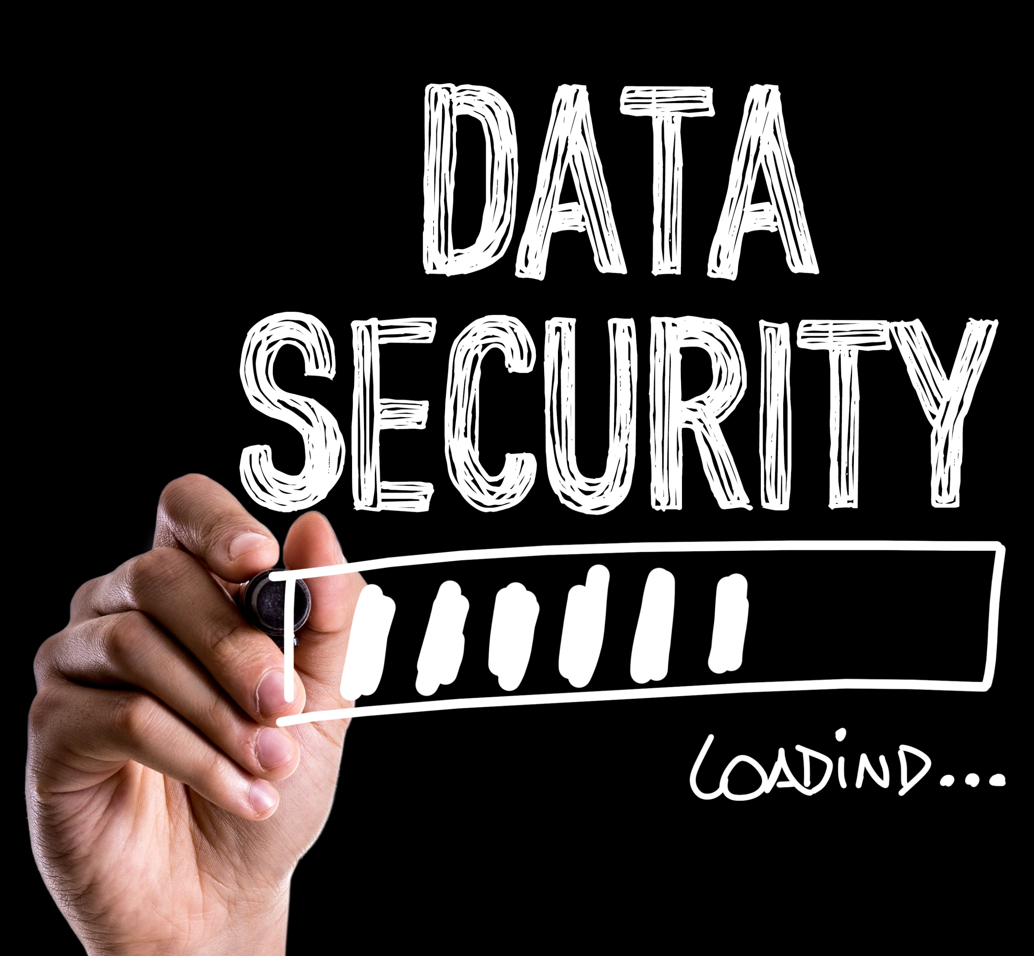


TPR – The foundations of Business Continuity
There is an opportunity for success
Training
Prevention
Remediation
Educate your users and continually test their awareness to emerging threats using SET
Actively use technology you already own to avoid Ransomware and data exfiltration/theft
Be able to recover quickly and quietly when Ransomware happens and other losses occur
Notes:
The most important thing is educating your users, not with boring required reading or recordings but with exciting and engaging live presentations.
The next thing is using the technology you already own to your advantage.
Lastly IS being able to recover quickly and quietly when events do occur, and they will occur no matter what!

Slide 13

Be successful - Know who’s on first
Understanding all the components is the key to preventing incidents
Perform Social Engineering Toolkit (SET) tests
Do Network Penetration Testing
Use Network Segmentation
Deploy policies based on current guidelines
Require 2FA
Implement a true DMZ
Use best-of-breed Endpoint Protection
Keep firmware up-to-date
Train your users
Notes:
Understanding and managing all of the components with a ‘Whole Picture” attitude is key to improving overall security.
No one product or suite is the solution
In the end, embracing known Best Practices is the best protection your Organization can deploy

Slide 14

Prevention
Active measures to improve security
Notes:
As far as active Prevention is concerned, there are some things that only your IT department can implement,
However, in order to provide the right support and guidance, you may need to understand better.

Slide 15
Identity
Smart and logical policies for your users
Notes:
In most Organizations, digital Identity management is implemented using decades-old standards.
Not only can out of date standards be ineffective, they are often counter-productive.

Slide 16
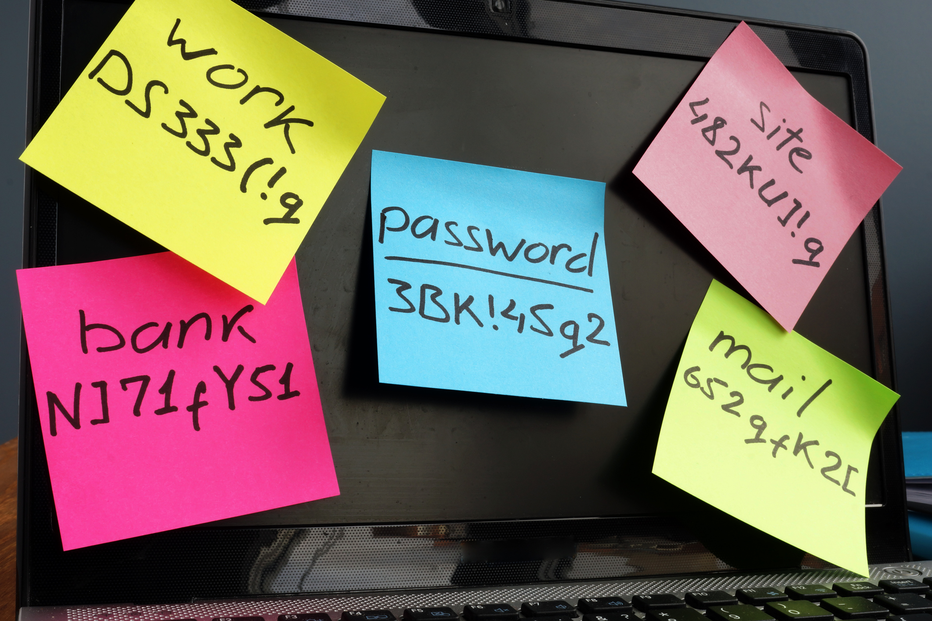
There's more to Password Policy than you think!
Use intelligent password policy
  Most password policy is based on dogma, and some is counter-productive
  How many users have written down their password in plaintext (on a Post-it even!)
  How many people store sensitive information (passwords) in un-encrypted documents (*.docx, *.xlsx)
  How often are passwords shared by users on your Organization (“Hey, Bob, login as me with the password 1234Mainstreet#!”)
Notes:
Remember, the human brain only has 7 or 8 “registers” for certain types of information – such as passwords and combinations.
If you ask us often enough to change our passwords, sooner or later we are going to have to write those passwords down.
When we do write those passwords down, we often use post-in notes, scraps of paper, or un-encrypted documents
Lastly, individual usernames and passwords should NEVER be shared between users – it’s an unacceptable workaround!

Slide 17
NIST Digital Identity Guidelines 800-63-3
The DO’s
The DO NOT’s
DO allow use of passphrases
DO allow the use of cut & paste for passwords
DO favor users, not administrators
DO enforce password length
DO create a banned-list and compare passwords to known-bad passwords
DO enforce timeout for inactivity
DO allow users to see their passwords in plain text
DO NOT require numbers, special characters or enforce composition rules
DO NOT use hints or questions
DO NOT enforce password aging
Notes:
In 2017, the NIST acknowledged the obsolescence and even absurdity of most password policy when it released the initial version of Special Publication 800-63B
We’ve gone over this relatively long document and distilled the following items, which are relevant to your Organization.
_______
DO allow use of passphrases
NIST Says (5.1.1.2): “Verifiers SHOULD permit subscriber-chosen memorized secrets at least 64 characters in length. All printing ASCII [RFC 20] characters as well as the space character SHOULD be acceptable in memorized secrets.”
DO allow the use of cut & paste for passwords
NIST Says (5.1.1.2): “Verifiers SHOULD permit claimants to use “paste” functionality when entering a memorized secret.”
DO favor users, not administrators
NIST Says (6.1.3): “password policies should be user friendly and put the burden on the verifier”
DO enforce password length
NIST Says (5.1.1.1) “Memorized secrets SHALL be at least 8 characters in length”
DO create a banned-list and compare passwords to known-bad passwords
NIST Says (5.1.1.2): “compare the prospective secrets against a list that contains values known to be commonly-used, expected, or compromised”
DO enforce timeout for inactivity
NIST Says (4.3.4): “Reauthentication of the subscriber SHALL be repeated following any period of inactivity lasting 15 minutes or longer”
DO allow users to see their passwords in plain text
NIST Says (5.1.1.2): “offer an option to display the secret — rather than a series of dots or asterisks — until it is entered”
DO NOT require numbers, special characters or enforce composition rules
NIST Says (5.1.1.2): “Verifiers SHOULD NOT impose other composition rules (e.g., requiring mixtures of different character types or prohibiting consecutively repeated characters) for memorized secrets.”
DO NOT use hints or questions
NIST Says (5.1.1.2): “Memorized secret verifiers SHALL NOT permit the subscriber to store a “hint” that is accessible to an unauthenticated claimant. Verifiers SHALL NOT prompt subscribers to use specific types of information (e.g., “What was the name of your first pet?”)
DO NOT enforce password aging
NIST Says (5.1.1.2): “Verifiers SHOULD NOT require memorized secrets to be changed arbitrarily (e.g., periodically). However, verifiers SHALL force a change if there is evidence of compromise of the authenticator.”

Slide 18
Deploy two-factor Authentication (2FA)
2FA helps to make sure only authorized users access sensitive data
  The addition of phone, SMS, or other second-factor drastically reduces the possibility of unauthorized access
2FA is the standard in improving security
Notes:
When it comes to authentication, there’s no better way to prevent brute-force attacks than deploying Two Factor Authentication (2FA)
2FA takes your username and a password, then makes sure you have something else as well, like receiving and replying to a text message, or a push-notification on an app.
A recent famous Ransomware incident could have been avoided merely by having 2FA in-place on the systems in question.

Slide 19
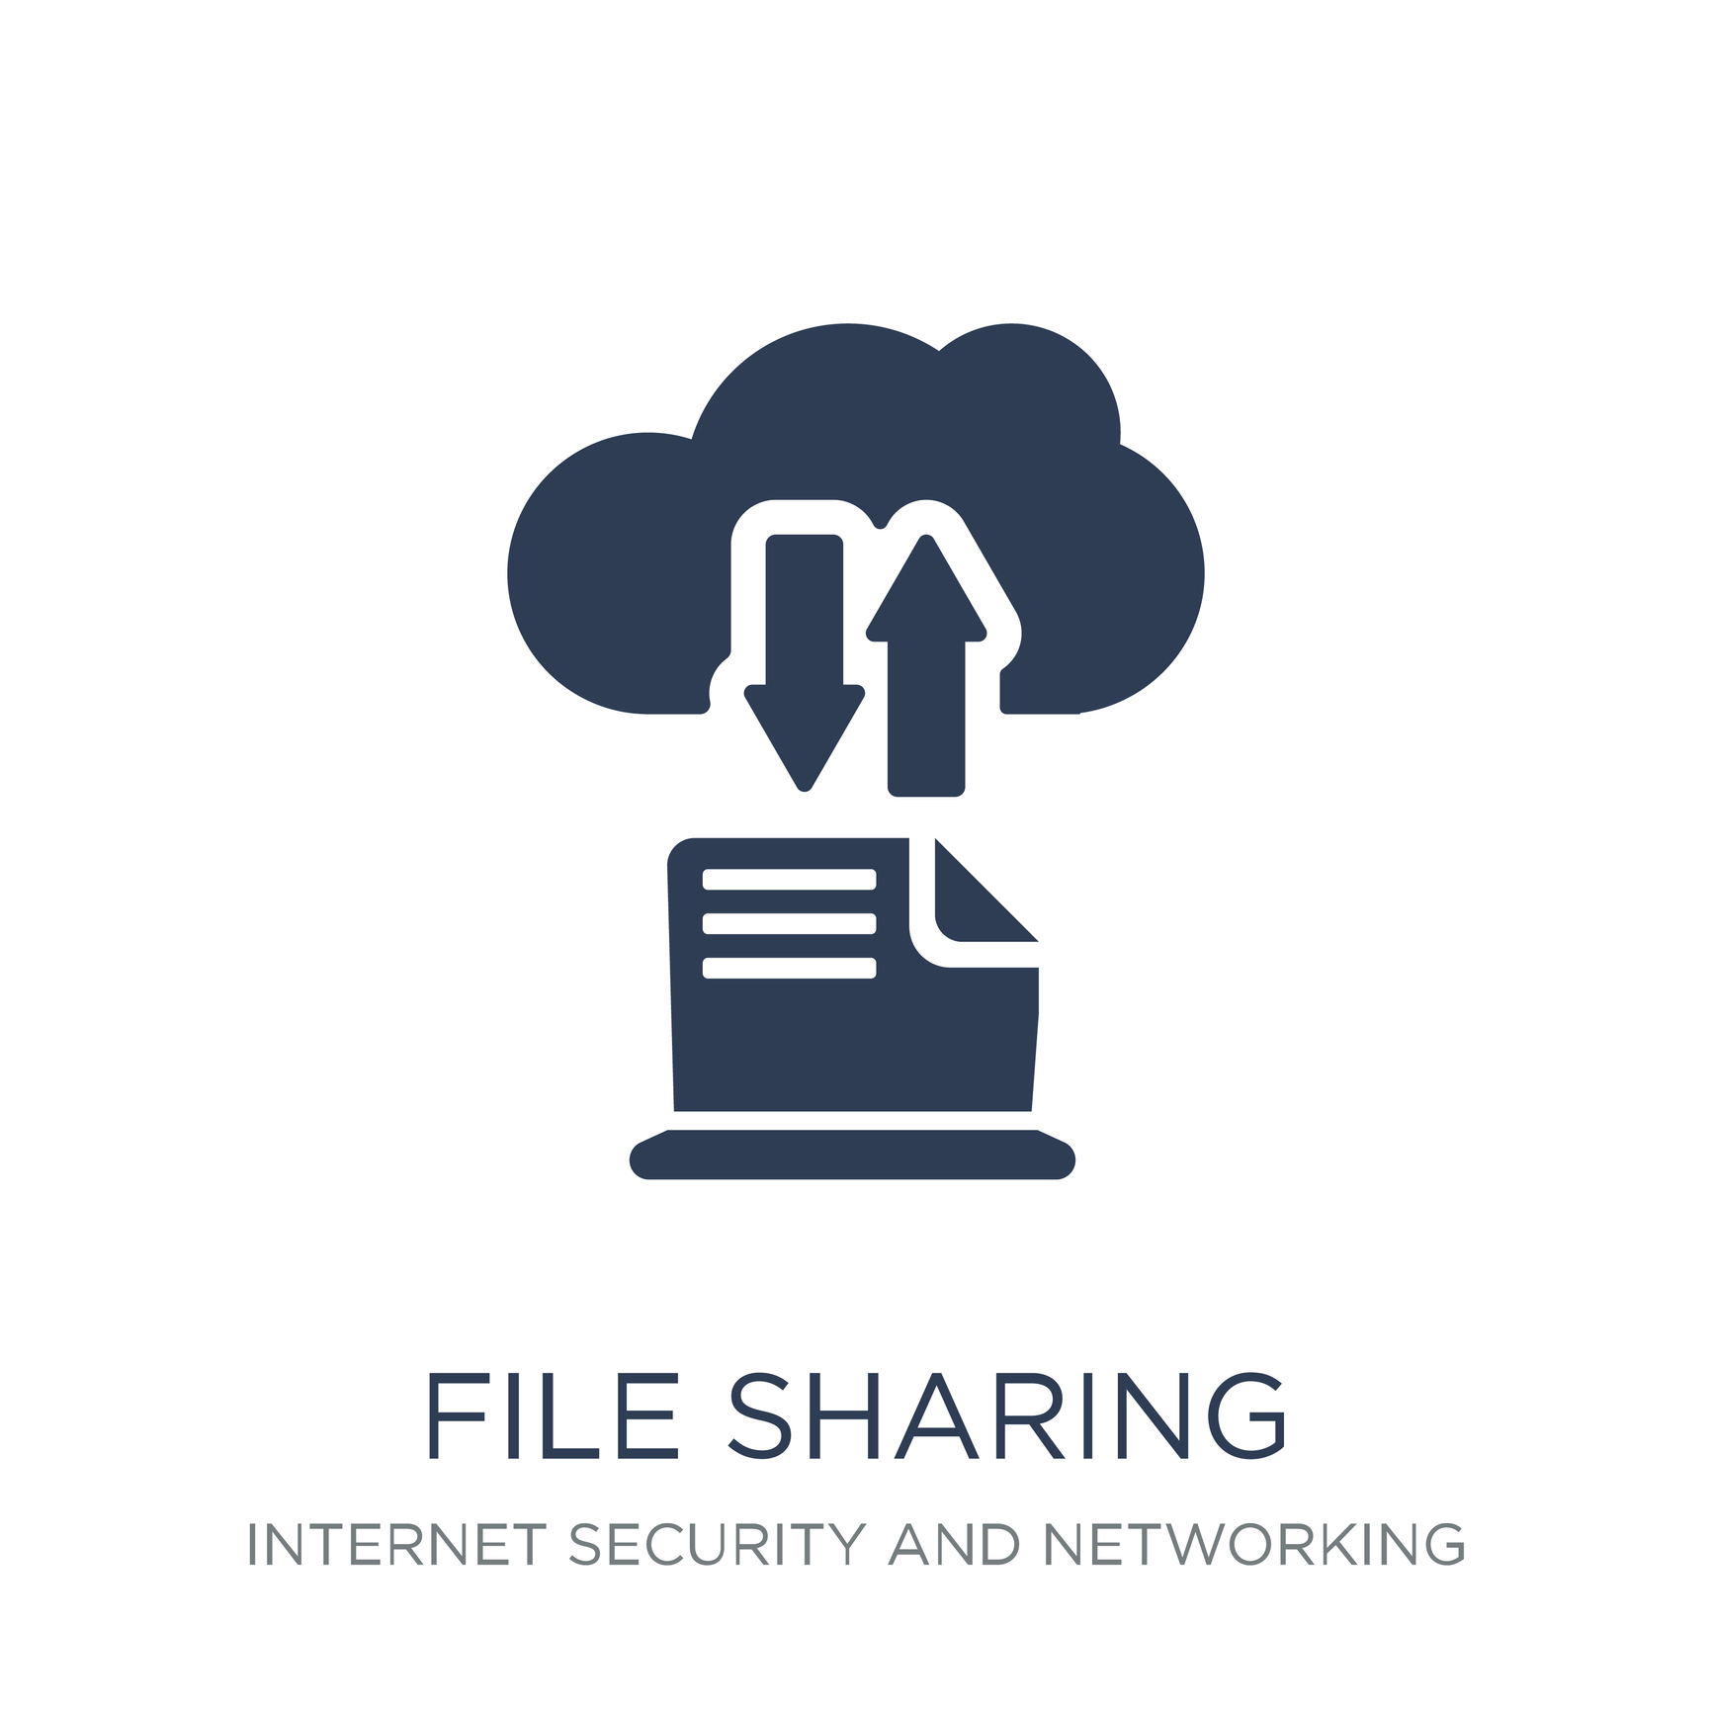
File Sharing
Needs to be usable and secure
Windows file servers should be permissions-based
  Each user entitles to only certain files based on Active Directory
Avoid users leveraging Public Cloud services or email to transfer files from ‘work” to personal computer resources
Users data MUST be readily available or users will circumvent normal security procedures with USB Drives, email or Public Cloud file sharing
Notes:
File sharing can be another big problem area. All too often, Organizations make file sharing difficult or inconvenient.
This is especially true where the remote worker and home office are concerned.
All too often, we see users leveraging Public Cloud like Dropbox or even emailing files to a personal account
At minimum, file shares should be permission-based to prevent Ransomware from propagating.

Slide 20
VMsources MSP and Consulting
What VMsources can do for your Organization
VMsources can assist in the deployment and adoption of 2FA for your Organization
VMsources can assist with updating Active Directory Password and Security Policy
  NIST Recommendations based on NIST Digital Identity Guidelines 800-63-3
  Group Policy and Security Policy to inhibit Ransomware
VMsources can help to deploy and validate permissions-based file-shares and file sharing
VMsources can deploy secure Linux-based filesharing services
Notes:
VMsources is a full-service MSP focusing on Infrastructure and Cloud Computing
That means we can help your IT team deploy or improve Digital Identity guidelines for your Organization.
We can help deploy 2FA, we can assist in improving Password Policy, and we can provide secure windows and non-windows file-sharing solutions

Slide 21
Network
Network segmentation and firewalling means Security
Notes:
Network design and implementation is one of the weakest areas for many Organizations

Slide 22
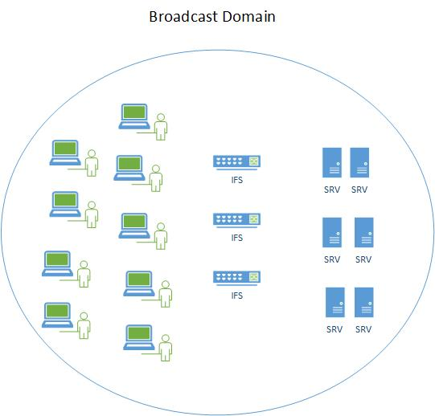



Understanding a Broadcast Domain
Lack of Network Segmentation often gives Ransomware the foothold it needs
Broadcast Domains are unrelated to Active Directory
People often use the terms: “Network,” “Subnet,” “VLAN” interchangeably to refer to the concept of Broadcast Domain
Refer to a contiguous Network Segment where all hosts can “talk” to each other without restriction
Within a Broadcast Domain, Malware, Ransomware and Exploits can spread easily
  Workstations
  Servers
    AD, Mail (Exchange), SQL, Terminal Server, Citrix
  Infrastructure
    VMware, Backup, Edge (L3)
Notes:
Broadcast Domains are unrelated to Active Directory entirely. In fact, they have nothing at all to do with authentication.
A Broadcast Domain is a single, contiguous network, where all of the hosts can talk to one and other freely.
We often use the terms “Network,” “Subnet,” and “VLAN,” interchangeably, when what we are really meaning is Broadcast Domain
Problem is: many Organizations deploy everything within a single Broadcast Domain.
This allows Ransomware to spread without restriction to any other host on the Broadcast Domain for which it has or can brute-force credentials

Slide 23
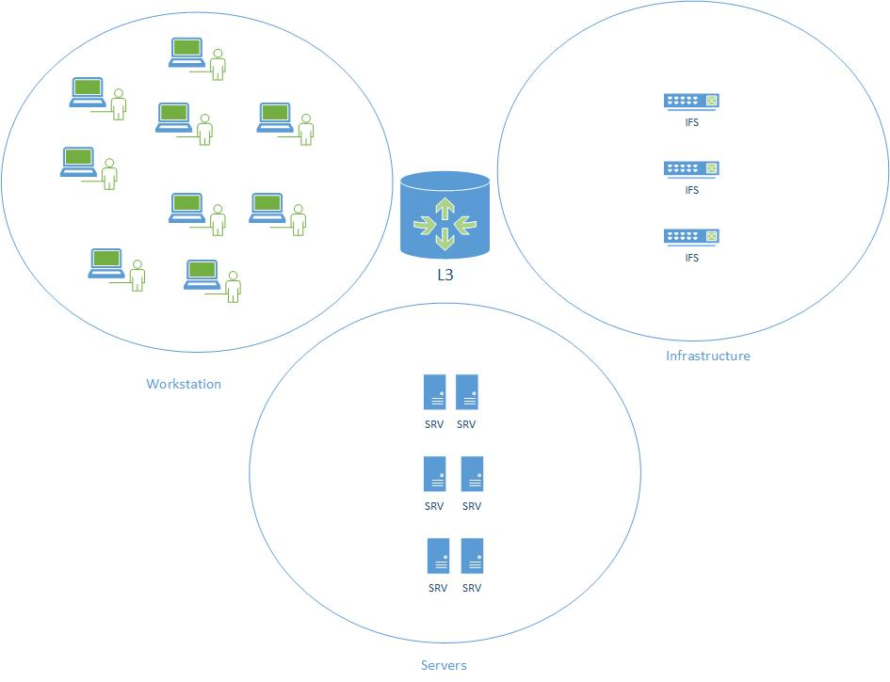
Network Segmentation
Network Segmentation alone is a huge step forward
Network segmentation means moving different categories of system to unique Broadcast Domains
  Workstation Network
  Server Network
  Infrastructure Network
Communication (AKA: “traffic”) can not pass between different Broadcast Domains unless passing a Firewall
Routers/Firewalls (L3) inspect traffic and permit or deny based on factors such as:
  Source/Destination
  Application (Email, SQL, Web)
Notes:
Network Segmentation is a universally recommended Best Practice to improve security
By dividing hosts up by category, and placing each category on an unique Broadcast Domain, we can control traffic with a Firewall
For example, if we place our Workstations on one Broadcast Domain, Our Servers on another and our Infrastructure on a third, we have made a vast improvement in security.
We can further improve that security by adding rules to permit only certain types of traffic between different Broadcast Domains.
For example, we might allow only management traffic to pass from the servers Broadcast Domain to the Infrastructure Broadcast Domain, eliminating access from our Workstations entirely.

Slide 24
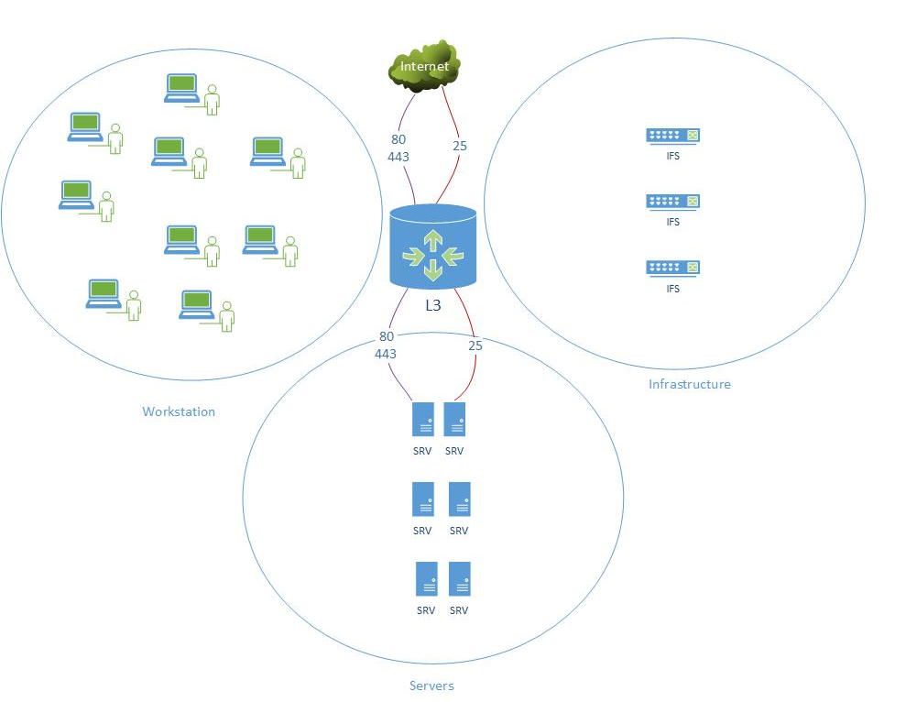
Port Forwarding (NAT) can be dangerous
Firewalls and Routers can only do so much for security without a DMZ
Applications announce what they are supposed to be using “Ports”
Port Forwarding is directing certain types of traffic such as Web or Email to the correct Server
Hackers are able to announce incorrect Ports to introduce exploits
Port Forwarding from the Internet to any general-purpose Broadcast Domain is a bad idea
  Remote-code execution vulnerabilities could allow hackers to reach any other system within the Broadcast Domain
Notes:
Many Organizations use NAT to direct certain types of traffic from the Internet to a Server.
This is a mistake, if that Server is on the same Broadcast Domain as other Servers
Applications identify themselves using “ports,” which are actually numeric identifiers built into the Envelope, also known as the Ethernet Frame’
If the application is a Web Browser, it usually identifies itself with ports 80 & 443
Under normal circumstances, your Firewall will take that Web traffic and send it to the Web Server
Problem is: if a Hacker misuses port 80 or 443 by trying something other than Web Traffic, they may gain access to your systems.
Again, if those systems co-exist on the same Broadcast Domain as other servers, there are vulnerabilities.

Slide 25
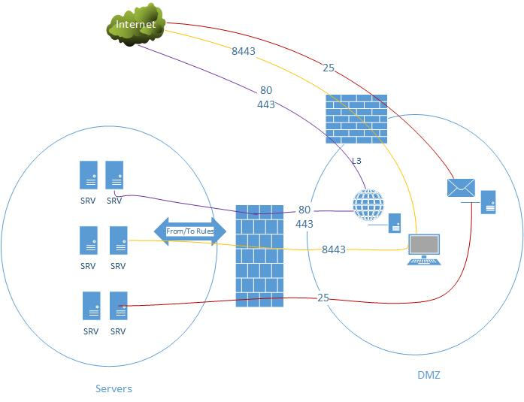
True DMZ
Network Segmentation with a true DMZ is the best network policy to prevent propagation of Ransomware
A true DMZ (Demilitarized Zone) is a dedicated Broadcast Domain containing Internet-facing servers and/or dedicated proxy-servers
  Web servers often exist entirely in a DMZ
  Mail servers (such as Exchange) often place an Internet-facing proxy in the DMZ
  Virtual Desktop Infrastructure (VDI) should have a Secure Gateway server in the DMZ
DMZ entities should NOT be a member of Active Directory
Notes:
The best-case scenario is one which includes a true DMZ
Any server that requires any exposure to the Internet should be in the DMZ
Not only are the connections from the Internet limited to the single Server which they are intended for, but DMZ Servers are not part of the Active Directory on purpose.
That way, there’s no information or cached credentials to compromise with scripts like Mimikatz
When the Servers in the DMZ get authorized traffic, they forward that traffic using from:to rules only to an authorized recipient.
In the event someone compromises a DMZ server, there should be no information to steal.

Slide 26
Stateful Firewall with active ruleset
Geo-IP Blocking
  Block countries or entire continents which are not relevant to your Organizations
Domain Name Service (DNS) Blocking
  Active DNS Blocklists prevent users from going to known bad addresses
Content Filtering
  Limit or prevent traffic based on content type as appropriate for your Organizations
Secure Delivery
  Prevent access to addresses which do not have HTTPS/SSL secured by a Trusted Certificate Authority (CA)
Notes:
Your Firewall should also include active rulesets
There are free and subscription-based lists available for almost every type of device
Geo-IP blocking is one of the most important. If you have no users in the Ukraine (for example), then block that traffic
DNS Blocking will prevent your users from browsing to known-bad websites
We prefer a Cloud Firewall called pfSense, but work with all types of Firewall

Slide 27
VMsources MSP and Consulting
What VMsources can do for your Organization
VMsources can help create VLANs and then implement Network Segmentation with unique Broadcast Domains for:
  Desktops
  Servers
  Infrastructure
VMsources can help move Web-facing servers into a true DMZ and/or create secure non-AD proxy Servers
VMsources can help to remove critical IT Infrastructure (such as: Backup Servers, VMware and Hyper-V) from the main AD domain
VMsources can help deploy Virtual Firewall technology to implement active protection and Geo-IP blocking

Slide 28

Remediation
Addressing Business Continuity when bad things happen (and they will happen)
Notes:
It’s important to remember that bad things are going to happen, no matter how well your Organization has prepared.

Slide 29
Things are going to happen
Don’t let your Organization be the next headline news
No matter what you do, something is likely to slip through the cracks.
Being able to failover to a DRaaS facility or recover quickly from backups is the threshold by which you will be judged.
Set the standards in advance, there’s no such thing as a zero-downtime event!
  The media has taught us that outages of days and huge ransom payments are the NORM!
  Be the hero if you can be fully online in 24 hours or less without paying ransom.
Common Thresholds:
  Organizations with DRaaS can expect to failover fully in about 4 hours
  Organizations protected by Immutable Backups can expect to recover over a period of about 24 hours
SUCCESS = Rapid failover and/or recovery
FAILURE = Extended disruption, loss of data, exfiltration, and paying ransom
Notes:
The most important thing of all is being able to recover quickly when bad things do happen
and not allow your Organization to become the next headline news.
One key aspect of success is in setting the standards for recovery in advance:
The less downtime required, the more expensive the solution.
Organizations that deploy true Disaster Recovery as a Service, with replication to a live site can expect failover in 1-4 hours after declaring an event
Organizations that are protected by Immutable Backups can expect to fully recover in a much longer period of time, but usually less than 24 hours.
The reason is that Backups are compressed archives and take time to restore, whereas DRaaS replicas are ready to go.

Slide 30
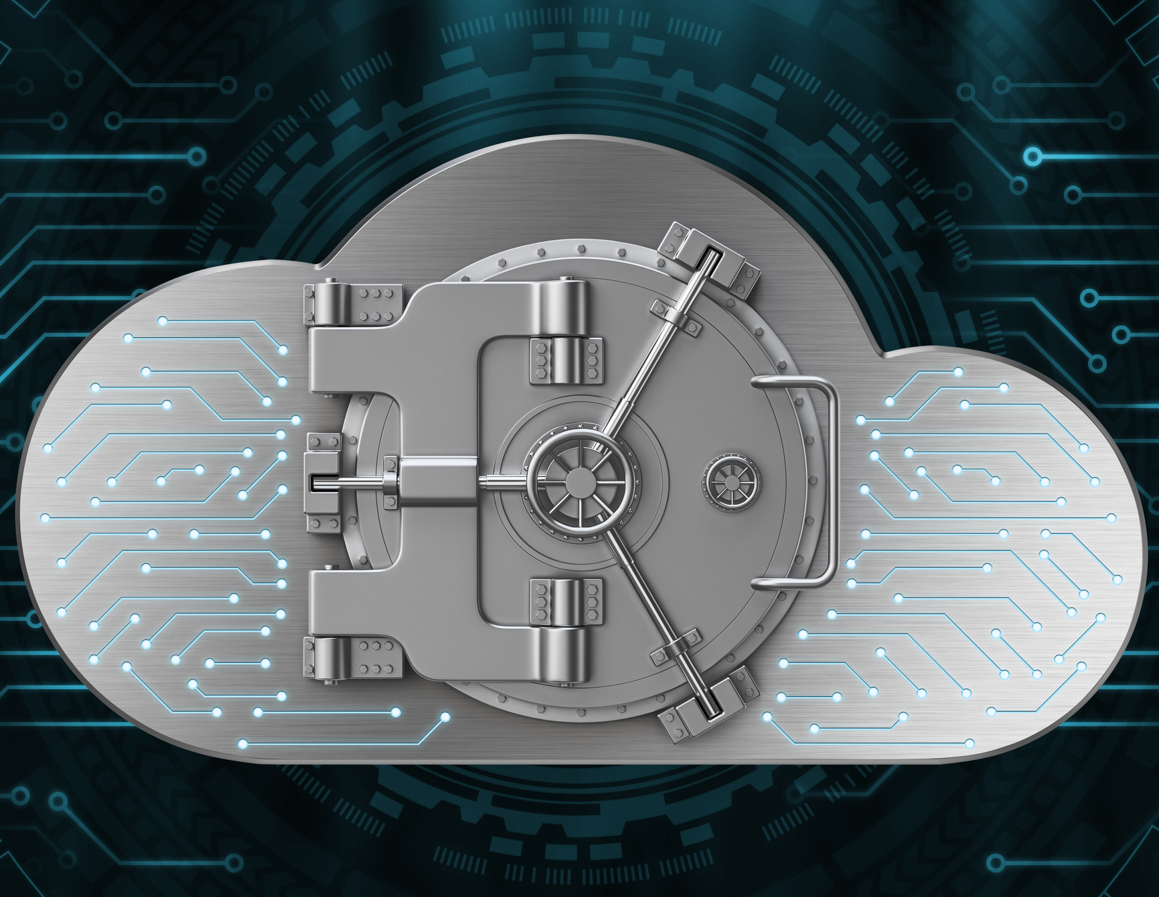
Hardened Backups
Existing Backup systems can improve
A huge problem is Organizations which join Backup Servers and VMware vSphere servers to the AD Domain
  This effectively allows Ransomware to encrypt the backup files and VMs directly!
Here are some recommendations:
  GOOD: Do NOT join your Backup Server or Repository to AD Domain
  BETTER: Follow 3-2-1 Rule
  BEST: Combine the two suggestions above with or Immutable Backup technology
Notes:
One of the most important concepts regarding protection from Ransomware is Hardened Backups.
Many of the significant Ransomware events which resulted in extended outages were the result of sub-optimally deployed Backup technology.
One BIG mistake is leaving Organizational Backup and Infrastructure servers as members of your general-purpose Active Directory Domain.
In the event that someone with administrative credentials imitates a Ransomware process, it will likely be able to encrypt Backups and even entire Infrastructure Systems.
The easy solution is to take all Backup and Infrastructure servers off the general-purpose AD Domain, instead using local authentication with strong credentials.
The best solution is to implement Immutable Backups whereby recent backup files are not changeable by anything, leaving your Organization with a viable state just before the event occurred.

Slide 31
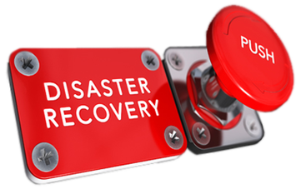
Disaster Recovery as a Service (DRaaS)
DRaaS is the way when rapid recovery is the goal
Deploy an effective Disaster Recovery plan
  DR or DRaaS should address both physical disasters and logical ones
    DRaaS maintains a current copy (Replica) of all mission-critical systems at a DR site
    Understand how far back a replica can be restored (in case of ransomware)
Test that plan to understand the implications
  Public IP addresses, DNS, Active Directory and more can all present unanticipated challenges
Understand the costs of testing and failover
  Some providers charge exorbitant prices for running any form of failover including testing
Notes:
Disaster Recovery as a Service is a step beyond backups.
DRaaS maintains a current state of all the critical systems your Organization requires to operate at a site which is both geographically distant and connected to backbone Internet.
In specifying DRaaS parameters, it’s important to understand how far back it’s possible to turn the clock.
In other words, if Ransomware happens and your DRaaS plan only retains 8 hours of data, the oldest recent state of mission-critical systems may not be viable.
It’s also important to test your DRaaS provider. Most Organizations feel that an offline test is sufficient, where you power-on all DRaaS systems and test connectivity and performance.
The most selective Organizations require full DRaaS tests in production, where all users connect to the DRaaS site for up to a week.
Understand the costs of DRaaS Testing, many providers will charge exorbitant hourly rates when DRaaS systems are powered-on.

Slide 32
VMsources MSP and Consulting
What VMsources can do for your Organization
VMsources knows and understands Backups and DRaaS better than anyone else.
We’ll build a white-glove DRaaS plan specifically for your Organization.
  We’re happy to respond to RFPs through normal purchasing channels as well.
We can assist your Organization with hardening existing technologies.
We can deploy Veeam Immutable Repositories at your location or in our Cloud to protect against Ransomware.
We’ll help you write an IT Business Continuity Plan that will:
  Establish realistic expectation for events and recovery
  Spell out “Who’s on first” by diagraming every component of the Backup and/or DRaaS systems and what it does.
  Provide easy-to-follow flowcharts
Notes:
VMsources can help your Organization with a full-spectrum of Business Continuity requirements,
from hardening existing backup systems, to deploying Immutable Backups
Moreover, we can deploy true DRaaS for your Organization and then help guide you through the complexities of testing and failover.
Don’t be caught unprotected, make sure your Organization is prepared to recover quickly is and when events do occur.

Slide 33

Training
Educate Users to prevent Ransomware attacks
Notes:
Training is the key to improving user habits

Slide 34

Training
Knowledge is the key to user success
Live events with team-building exercises are most effective
  Mandatory training will help users understand the threats and avoid common mistakes
  Understanding the challenges will make users sympathetic to new requirements
  Team building will improve participation in security initiatives
Webinars can work, but we know they are a drag!
Recorded sessions are least effective
Consider the following:
  In-person group training (with remote participants).
    The people in the room get the ball rolling and stimulate questions from the remote participants
  Lunch & Learn
    A small investment by your Organization will develop a positive attitude about the presentation
Notes:
Hold mandatory live events to engage users and keep them informed.
Use team-building so that users want to “get onboard” and stomp-out bad behaviors.
Use positive reinforcement whenever possible to encourage users good behavior.
Because we all know what a drag Webinars can be, consider hosting live events as soon as possible, also allowing remote participants.
Use the in-person audience to get the ball rolling, and the remote participants will chime right in.

Slide 35
Target Training Audience
Your entire Organization
The audience for IT Awareness Training is your entire Organization, even the techies and administrators who are already knowledgeable.
  The Techies will affirm the topics covered to their colleagues, creating confidence.
  The administrators will share real-world experiences and challenges.
  The bosses and supervisors presence will confirm the importance of the topic.
  Team-building will establish enthusiasm and cooperation.
Notes:
Your target audience needs to be your entire organization, from the head Honcho’s right down to the Interns.
Thing is, having the Honcho’s in the audience will tell everyone: “This is important”.
Having the Techies in the room will help to confirm the presenters topics
And the team-building will bring them all together with memorable, visual references

Slide 36
Training Agenda
Email security
  What Phishing looks like today.
  Testimonial + Q&A.
  How SET is being deployed to improve security.
2FA
  Why it’s important?
  How it works for your Organization.
  What's protected by 2FA and what’s not?
Filesharing
  The correct way to share files with colleagues, external recipients, even yourself
Passwords
  What is a good password?
  When can we share a password?
Sensitive Information
  What is sensitive information?
  How to use Microsoft Office to protect sensitive information.
  How to share sensitive information with authorized people.
Ransomware avoidance
  Common ways Ransomware finds its way into systems and across firewalls.
Notes:
A sample training agenda should include all the topics relevant to your Organization
Don’t go down rabbit holes and don’t cover topics which are only conceptually relevant.
Remember, we’re trying to accomplish a goal in 1-hour or so, without loosing the audience.

Slide 37

Secure Cloud
Multicloud Powered by VMware and Proxmox VE

Slide 38
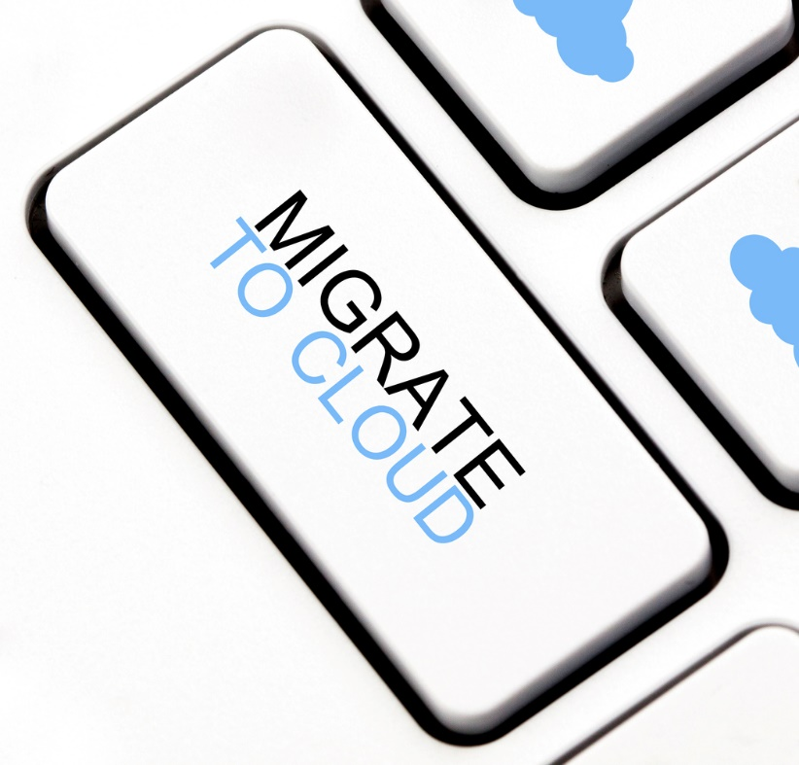
Call to action – Secure Cloud
Powered by VMware vCloud with vSAN
About half the cost of Amazon and other Big Clouds
  Compare for yourself at: https://calculator.s3.amazonaws.com/index.html
  Fixed and guaranteed 36-month TCO (No Big Cloud will do that for you)
  Control the ever-increasing cost of IT
True Secure Cloud
  You get the flexibility you need with the security you require
  Multi-tier protection from Ransomware
  Dedicated Secure Cloud resources are guaranteed to you
Concierge Secure Cloud Management
  We’ll manage the migration process to the Secure Cloud
  We’ll make sure updates get applied
  We’ll allow you to turn your attention to higher value matters
Copyright © 2025, VMsources Group Inc. All Rights Reserved
Notes:
The first thing I’d like to give you is a Call to Action: why would someone choose the Secure Cloud?
There are a TON of reasons that I am about to present, but here are the biggies:
This is a true VMware Certified vCloud with vSAN storage
The Secure Cloud is about half the cost of Amazon and other big clouds,
Not only can you compare for yourself, but we’ll guarantee TCO and help control the cost of IT
We’ll also take care of all of the VMware dirty work that makes so many people anxious with worry
We’ll manage the migration process to the Secure Cloud
We’ll make sure updates get applied
We’ll allow you to focus on your enterprise applications and leave the specialized VMware management to us!

Slide 39
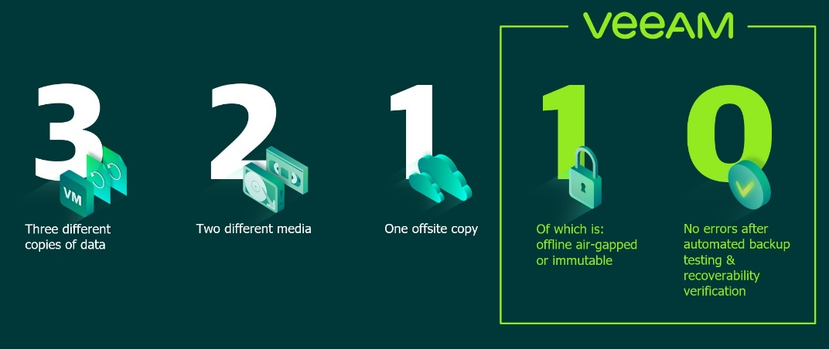
Secure Cloud
What we do to protect YOU from Ransomware
True 3-2-1 Rule Backup Compliance
  Local backups provide fast access to data and are the first component of the 3-2-1 Rule
  Remote backups provide the second component of the 3-2-1 Rule
  Veeam Replicas provide the third component of the 3-2-1 Rule
We use only Veeam Immutable repository technology
  Tested and proven by Cohasset Associates meeting the requirements for non-rewritable, non-erasable storage as specified by SEC 17a-4(f), FINRA 4511(c) and CFTC 1.31(c)-(d) – WORM Equivalency
Backup Repositories exist on dedicated SAN and Networks
Veeam 3-2-1-1-0 Rule
Copyright © 2025, VMsources Group Inc. All Rights Reserved

Slide 40


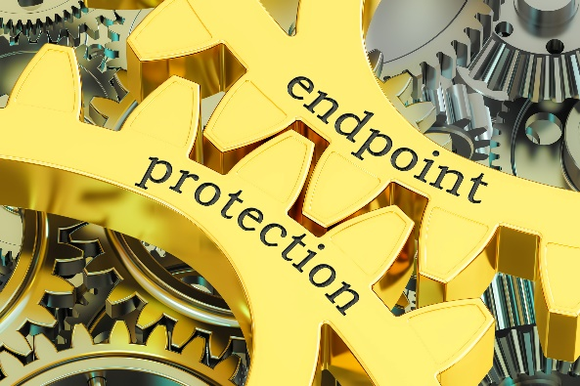
Secure Cloud
What we do to protect VMsources from Ransomware
VMsources edge systems use DUO Multifactor Authentication
VMsources uses strong, randomized passwords for Infrastructure Systems
  24 random characters or longer
VMsources complies with NIST Digital Identity Guidelines 800-63-3 Digital Identity Guidelines
VMsources uses dedicated Business Continuity domain for Backup and Infrastructure Systems
VMsources always encrypts passwords and all sensitive and proprietary data
Copyright © 2025, VMsources Group Inc. All Rights Reserved

Slide 41
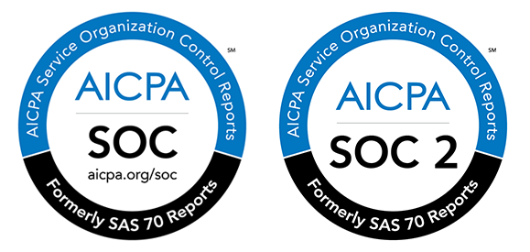

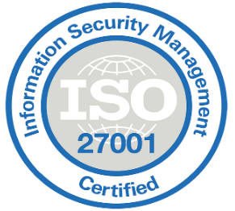


Secure Cloud
Certification & Compliance
AICPA Audited
  SOC 1
  SOC 2
ISO 27001 Certified
HIPAA Compliant
PCI DSS Compliant
Copyright © 2025, VMsources Group Inc. All Rights Reserved
Notes:
One of the constant challenges for on-site Compute is maintaining the appropriate Certification and auditing to Compliance Standards.
In the Secure Cloud, you will never have to worry about standards or auditing again!
All of the relevant standards have been met, with logos and compliance certificates available for you to incorporate into management and investment reporting!

Slide 42
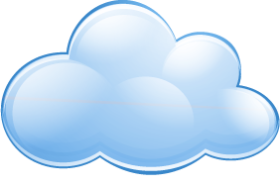


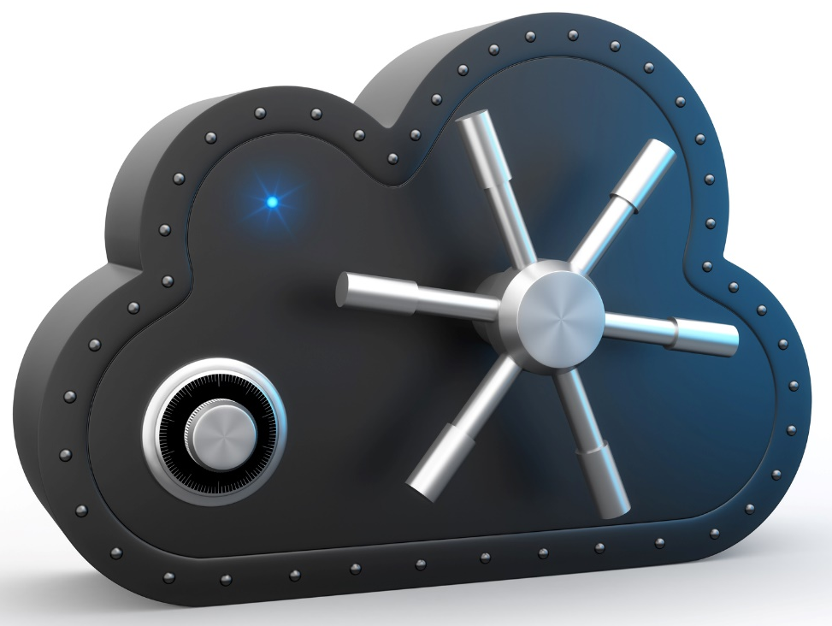

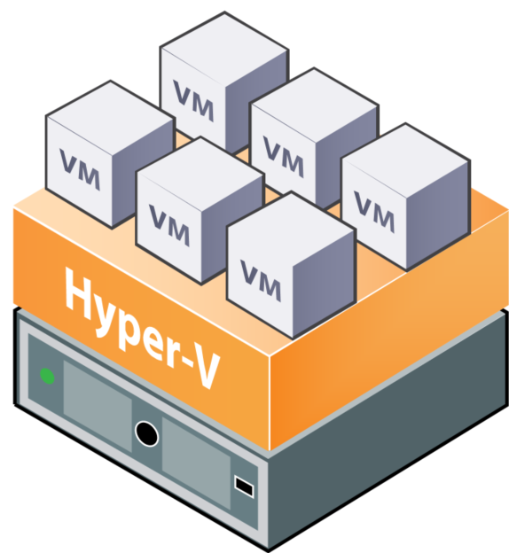
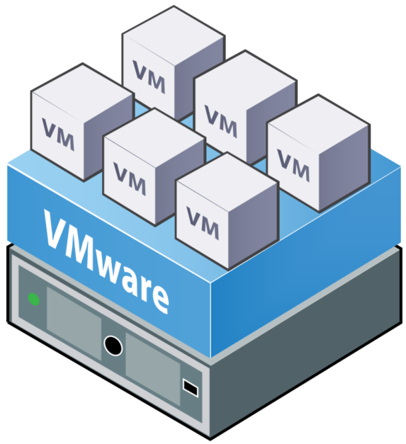


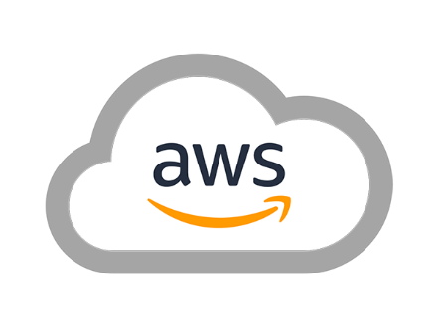




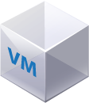


Secure Cloud
Public Clouds
Integration with both Public and Private Clouds
On-site Private Cloud
Secure Cloud
Secure Pipe #1
SSL - Secure
Security
SSL - Secure
Secure Pipe #2
SSL - Secure
User Portals
Workloads
Security
Copyright © 2025, VMsources Group Inc. All Rights Reserved
Notes:
The Secure Cloud is the solution is the solution Enterprise has been waiting for!
Migrate away from on-premises Compute to a Secure Cloud solution without sacrificing one iota of Security or Control.
The Secure Cloud is the ideal vehicle to integrate legacy on-premises workloads with a Fully-Managed five nines Secure Cloud and Public Cloud workloads as well.

Slide 43
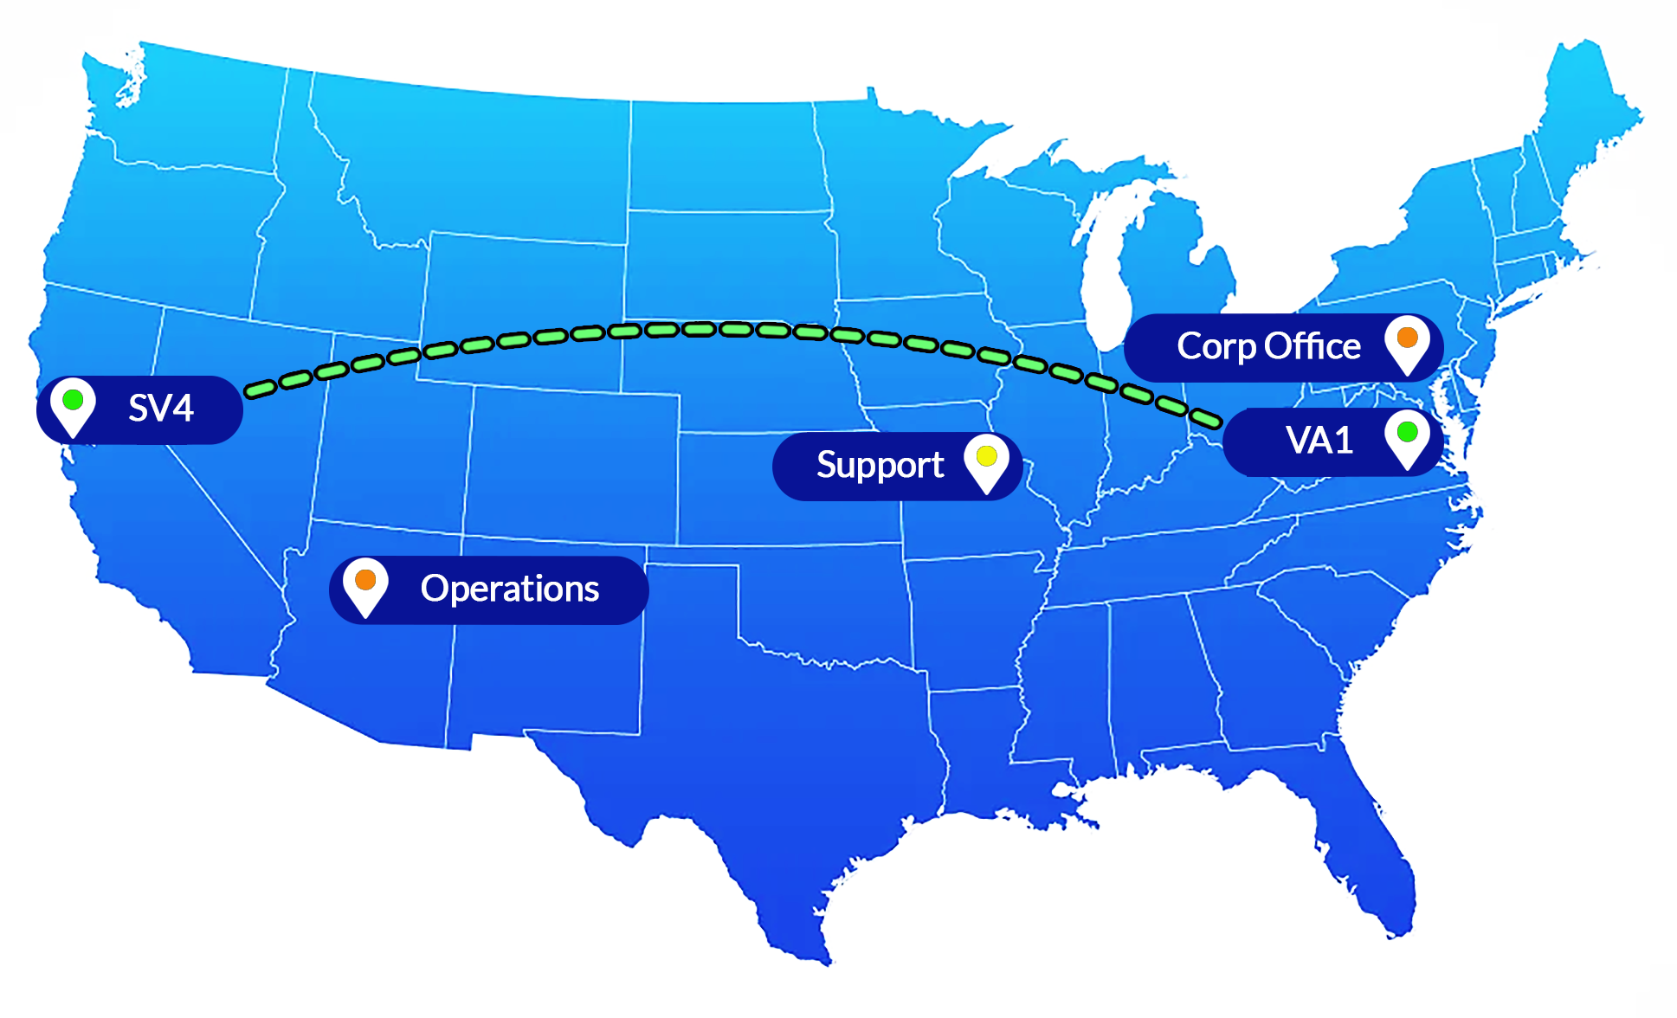
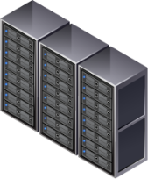


Secure Cloud Geo-Scale Diversity
Multiple Locations Guarantee Broad Network Access
North America Secure Cloud running VMware vCloud®
Compute
Network
Storage
Copyright © 2025, VMsources Group Inc. All Rights Reserved
Notes:
Reston Virginia (VA1) provides our US-EAST Compute Node
Highest Tier-4 Data Center Availability
45ms Latency to CONUS
Lower Latency to US-EAST
Santa Clara California (SV4) provides our US-WEST Compute Node
Highest Tier-4 Data Center Availability
45ms Latency to CONUS
Lower Latency to US-WEST

Slide 44
Secure Cloud
Why Choose VMsources Secure Cloud?
All Clouds will provide the resources you need
Only VMsources provides a pathway from your on-site Private Cloud to the Secure Cloud
Only VMsources provides complimentary knowledge transfer when migrating to the Secure Cloud
Only VMsources offers unlimited Tier 4 support tickets / sessions
Only VMsources offers guaranteed TCO
Only VMsources backs the 3-2-1 Rule with certification of your protection
Copyright © 2025, VMsources Group Inc. All Rights Reserved
Notes:
Bottom line, VMsources Secure Cloud includes not only the availability you require, but the service you need. [CLICK]
All Secure Cloud providers are good at meeting their SLAs and providing four nines uptime, but we go further. [CLICK]
From the moment you sign with VMsources Secure Cloud, we’ll help you plan your route to the cloud [CLICK]
And for the lifetime of your services, VMsources does not cap the amount of support we’ll provide. [CLICK]

Slide 45
Secure Cloud Glossary
Secure Cloud RAM
  The RAM (or vRAM) allocated to your powered-on VMs
Secure Cloud vDisk
  Super-fast vSAN SSD Virtual Disk for production VMs or Replicas
Veeam Backup SaaS
  Veeam Backup and Replication (Enterprise Plus Edition) Software as a Service
Veeam Immutable Repo
  A primary backup target for incremental backups, permitting fast restores and further offloads to alternate location(s) or Cloud(s).
  Veeam Immutable Repositories are tested and proven by Cohasset Associates meeting the requirements for non-rewritable, non-erasable storage as specified by SEC 17a-4(f), FINRA 4511(c) and CFTC 1.31(c)-(d) – WORM Equivalency
Wasabi S3 Immutable Repository
  Optional S3 Object storage in alternate Cloud Location
Copyright © 2025, VMsources Group Inc. All Rights Reserved

Slide 46
Secure Cloud Glossary
Grandfather-Son (GFS) Backup
  Long-term retention of full backups on a schedule (Weekly, Monthly, Yearly)
Incremental Backup
  One full backup supplemented on a schedule with backups containing the differences
Replication
  Stored on a Cloud Datastore, a Replica provides a ready-to-run copy of a Virtual Machine in an alternate location.
Copyright © 2025, VMsources Group Inc. All Rights Reserved

Slide 47
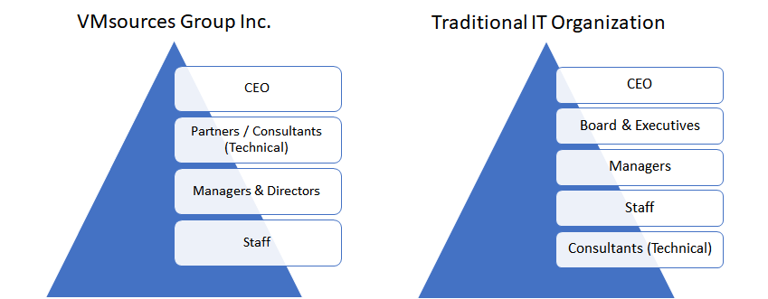
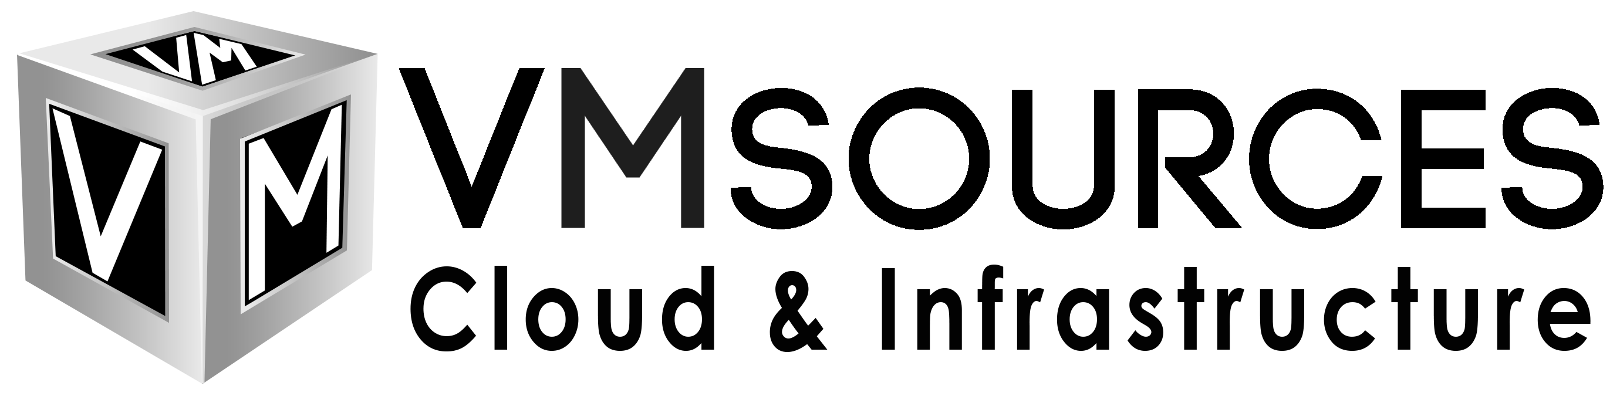
About Us
Simplicity is elegance
VMsources is a customer-facing MSP specializing in Private Cloud, Infrastructure, and Network.
It is VMsources mission to act as the client's advocate at every stage of the project, from concept to completion.
We are proud to bring the best technical guidance to the top of a traditional organizational structure.
Notes:
VMsources is a customer-facing MSP specializing in Private Cloud, Infrastructure and Network.
We’re proud to bring the best technical guidance to the top of a traditional organizational structure.
Let us help keep your Organization secure and protected.

Slide 48





VMsources Group Inc.
John Borhek
+1 215 764 6442 X1001
john@vmsources.com
https://vmsources.com/

